Slide 1
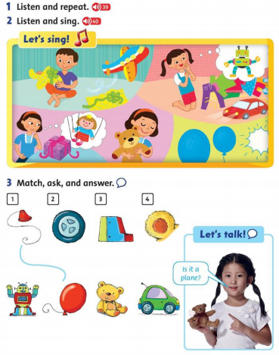
Tuesday, December 9th 2021 Unit 3: Is it a plane? Lesson 2

Slide 2
Is it a plane? Yes, it is. No, it isn’t.

Slide 3
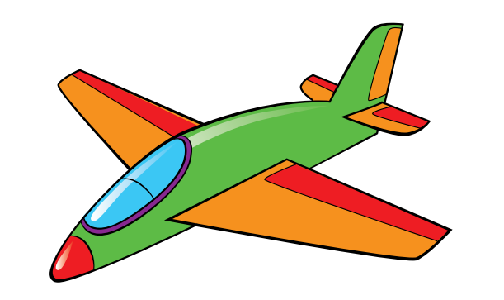
Is it a plane?
Yes, it is.

Slide 4
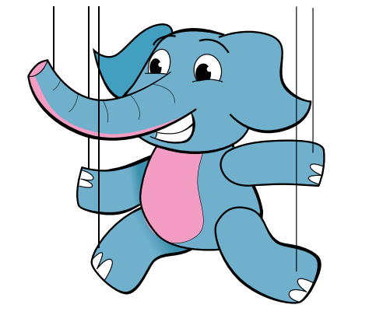
Is it a plane?
No, it isn’t.

Slide 5
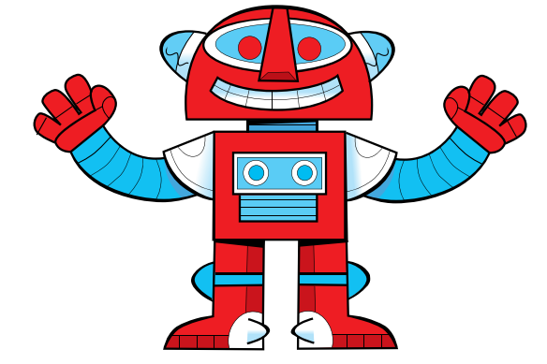
Is it a robot?
Yes, it is.

Slide 6
Is it a robot?
No, it isn’t.

Slide 7
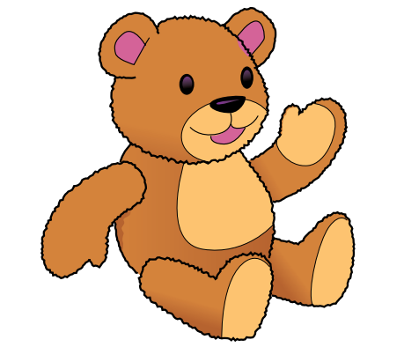
Is it a teddy bear?
Yes, it is.

